Slide 1
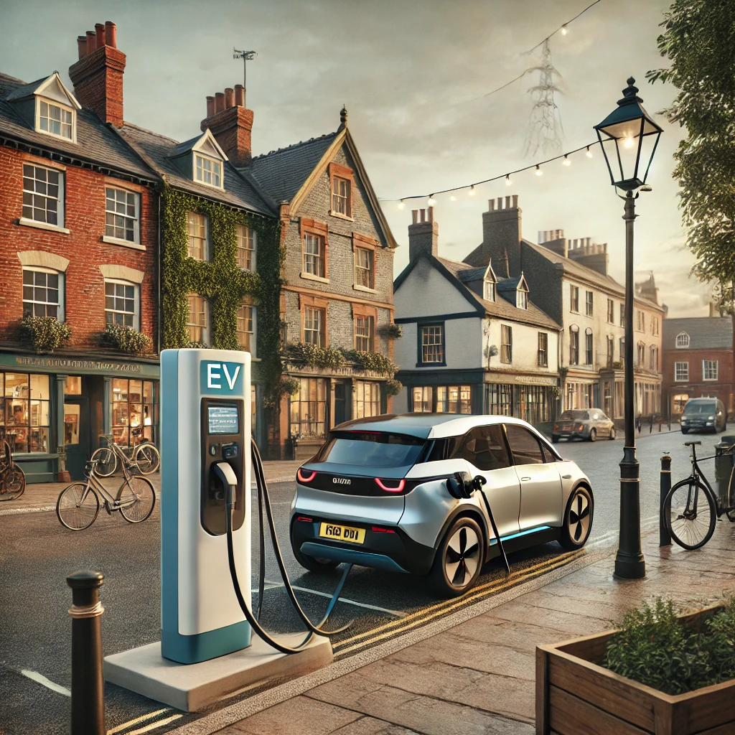
EV Charging Station Usage Prediction
Tiago Ferreira da Silva
Ironhack Data Science & Machine Learning Bootcamp
Nov 2024

Slide 2
Introduction
Challenge As more people switch to Electric Vehicles, companies installing Charging Stations need to ensure they’re located where demand is highest.
Project Goal Develop a machine learning model to predict the usage of a new EV charging station based on its location.
Why It Matters An overcrowded or underused station means unhappy customers or lost revenue.
Expected Outcome A data-driven tool that helps companies plan better, strategically placing chargers where they’ll be used most effectively.

Slide 3
DATA SOURCES
PAUA Dataset
Available Features & Target

Slide 4

Dataset Source Paua Tech
Paua is a UK-based company that provides a unified EV charging solution for businesses, enabling fleet drivers to access multiple networks with a single app and card.

Slide 5
Dataset Source Paua Tech
15 Locations x 7 Weekdays x 24 Hours = 2,520 datapoints
*one datapoint indicates the yearly consumption of 1 Charger for specific Weekday and hour

Slide 6
Dataset Source Paua Tech
Target variable

Slide 7
Dataset Avaiable Features & Target
Features:
Latitude
Longitude
Weekday
Hour
Charging_Capacity
Target Variable:
Charge_Percentage

Slide 8
Dataset Avaiable Features & Target
Features:
Latitude
Longitude
Weekday
Hour
Charging_Capacity
Target Variable:
Charge_Percentage
!!
Problem:
Not enough features to build a robust model !!

Slide 9
Dataset Avaiable Features & Target
Features:
Latitude
Longitude
Weekday
Hour
Charging_Capacity
Target Variable:
Charge_Percentage
!!
Problem:
Solution:
Not enough features to build a robust model !!
Data Enrichment

Slide 10
DATA ENRICHMENT
Demographics
Nearby Landmarks
Major Roads
Avg Traffic Volume

Slide 11

Dataset Enrichment How do we add relevant info to our Data?
Demographics:
Population, Population Density, Age distribution
Average Income, Cost of Living
Cars per 100 people
Percentage of EV
Nearby landmarks:
How many Food & Beverage in the surrounding?
Retail & Convenience?
Leisure & Entertainment?
Health & Services?
Promity to major roads:
Motorways, trunk, primary, secondary
Average Traffic Volume
Nearby Competitors

Slide 12
Dataset Enrichment How do we add relevant info to our Data?
Demographics:
Population, Population Density, Age distribution
Average Income, Cost of Living
Cars per 100 people
Percentage of EV
Nearby landmarks:
How many Food & Beverage in the surrounding?
Retail & Convenience?
Leisure & Entertainment?
Health & Services?
Promity to major roads:
Motorways, trunk, primary, secondary
Average Traffic Volume
Nearby Competitors

Slide 13
Dataset Enrichment How do we add relevant info to our Data?
Demographics:
Population, Population Density, Age distribution
Average Income, Cost of Living
Cars per 100 people
Percentage of EV
Nearby landmarks:
How many Food & Beverage in the surrounding?
Retail & Convenience?
Leisure & Entertainment?
Health & Services?
Promity to major roads:
Motorways, trunk, primary, secondary
Average Traffic Volume
Nearby Competitors

Slide 14
Dataset Enrichment How do we add relevant info to our Data?
Demographics:
Population, Population Density, Age distribution
Average Income, Cost of Living
Cars per 100 people
Percentage of EV
Nearby landmarks:
How many Food & Beverage in the surrounding?
Retail & Convenience?
Leisure & Entertainment?
Health & Services?
Promity to major roads:
Motorways, trunk, primary, secondary
Average Traffic Volume
Nearby Competitors

Slide 15
Dataset Enrichment How do we add relevant info to our Data?
Demographics:
Population, Population Density, Age distribution
Average Income, Cost of Living
Cars per 100 people
Percentage of EV
Nearby landmarks:
How many Food & Beverage in the surrounding?
Retail & Convenience?
Leisure & Entertainment?
Health & Services?
Promity to major roads:
Motorways, trunk, primary, secondary
Average Traffic Volume
Nearby Competitors

Slide 16
Dataset Enrichment How do we add relevant info to our Data?
Demographics:
Population, Population Density, Age distribution
Average Income, Cost of Living
Cars per 100 people
Percentage of EV
Nearby landmarks:
How many Food & Beverage in the surrounding?
Retail & Convenience?
Leisure & Entertainment?
Health & Services?
Promity to major roads:
Motorways, trunk, primary, secondary
Average Traffic Volume
Nearby Competitors

Slide 17
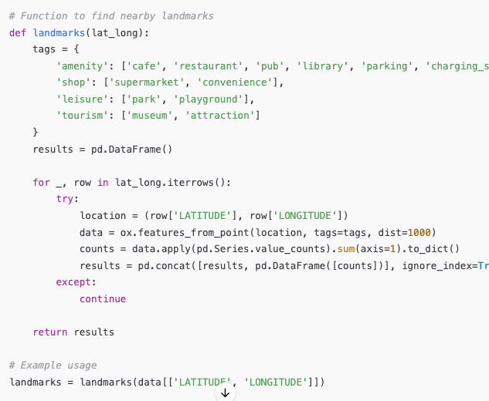
Dataset Enrichment Nearby Landmarks
Approach:
Use OpenStreetMap (OSM) API to retrieve geographic data
Finds nearby landmarks within a 1 km radius of each station location
Tags Searched:
Amenities: cafe, restaurant, pub, library, parking, hospital, etc.
Shops: supermarket, convenience, retail
Leisure: park, playground, sports center
Tourism: museum, zoo, attraction
Competitors: charging_station
Output:
DataFrame with counts of nearby landmarks categorized by type (amenity, shop, leisure, tourism)

Slide 18
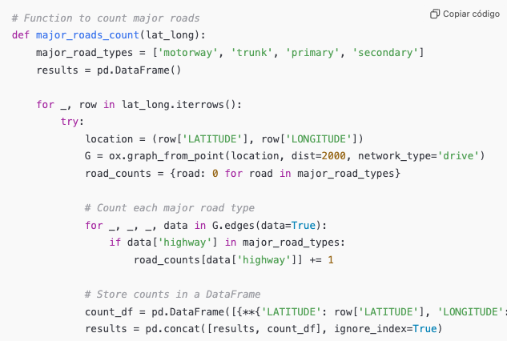
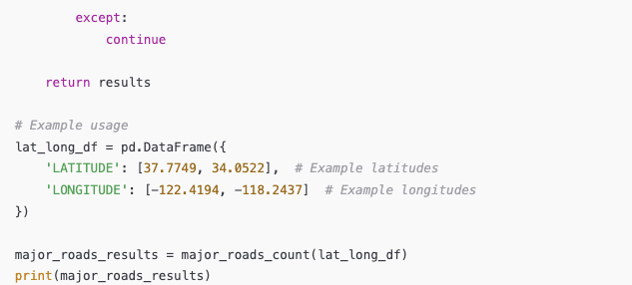
Dataset Enrichment Proximity to major roads
Approach:
Use OpenStreetMap (OSM) API to retrieve geographic data
Finds nearby major roads within a 2 km radius of each station location
Tags Searched:
motorway
Trunks
Primary
secondary
Output:
DataFrame with counts of nearby major roads

Slide 19
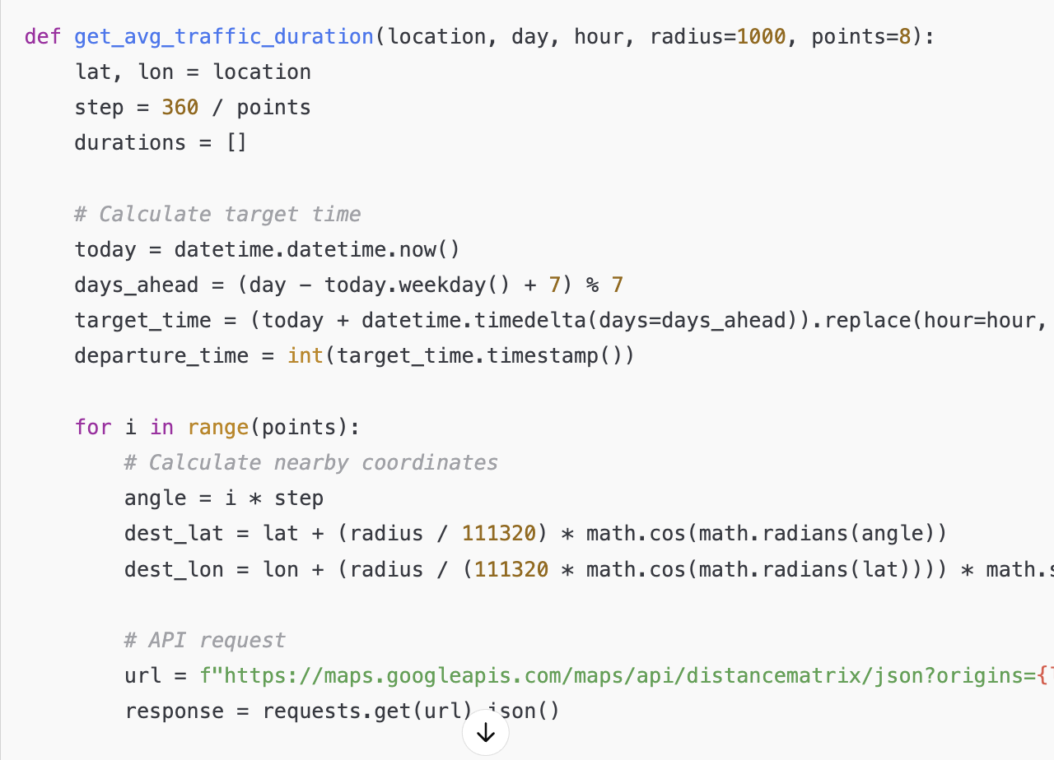
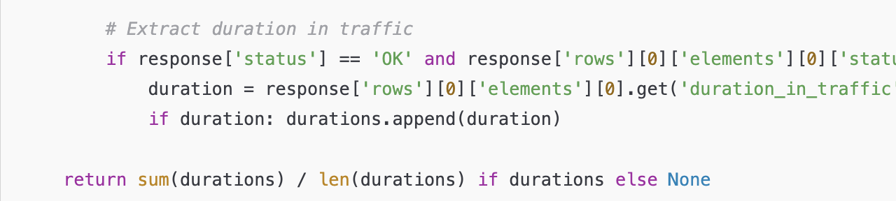
Dataset Enrichment Average Traffic Volume
Approach:
Use Google Maps Distance Matrix API to retrieve traffic-based travel duration.
Finds the average traffic duration to 8 nearby points within a 1 km radius around a specific location at a specified day and hour.
Parameters
Location: Center point (latitude, longitude)
target_day, target_hour
Output:
Single value representing the average duration in traffic around the specified location.

Slide 20
Dataset Enrichment Population & Demographics
Current Challenges
While demographic APIs are available, they can be challenging to use.
Data quality and reliability vary significantly between countries.
Manual Input Requirement
For our model, the user currently needs to research and manually input demographic data.
Future Direction
Integrate APIs to automatically extract demographic data based on location.

Slide 21
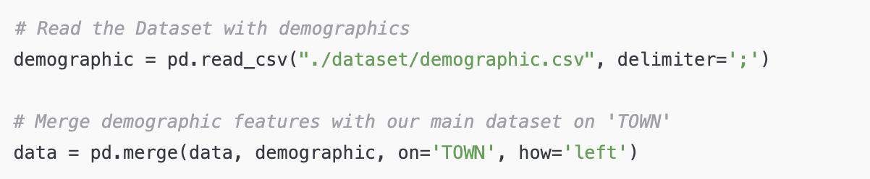
Dataset Enrichment Population & Demographics

Slide 22
DATA PREPROCESS
Grouping Amenities
Weekday names to int

Slide 23
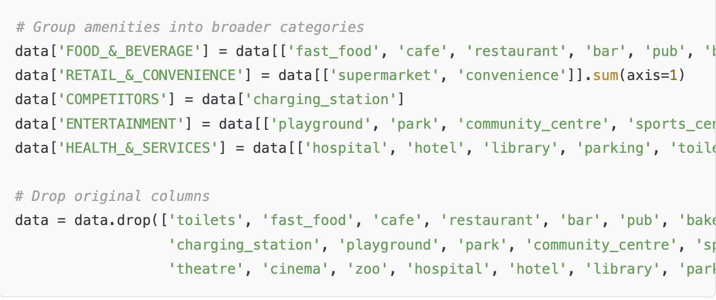
Data Preprocess Amenities Grouping
Simplify amenity data by grouping specific locations into broader, meaningful categories.
Broader Categories:
Food & Beverage: fast food, cafes, restaurants, bars, pubs, bakeries
Retail & Convenience: supermarkets, convenience stores
Competitors: other charging stations
Entertainment: parks, sports centers, museums, cinemas, zoos
Health & Services: hospitals, hotels, libraries, parking facilities, public toilets
Implementation:
Summing individual columns within each group to create a single category feature.
Dropping the original amenity columns to simplify the dataset.

Slide 24
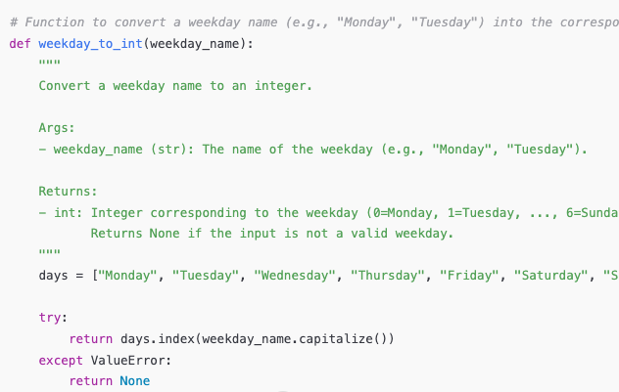
Data Preprocess Weekday names to Int
Convert weekday names (e.g., "Monday") to integers for easier data handling and analysis.
Mapping:
0 = Monday, 1 = Tuesday, ..., 6 = Sunday
Implementation:
A function weekday_to_int checks if the input matches a weekday name.
Returns the corresponding integer if valid, otherwise returns None.

Slide 25
FEATURE ENGINEERING
Hourly Categorization
Weekday Grouping
Encoding

Slide 26
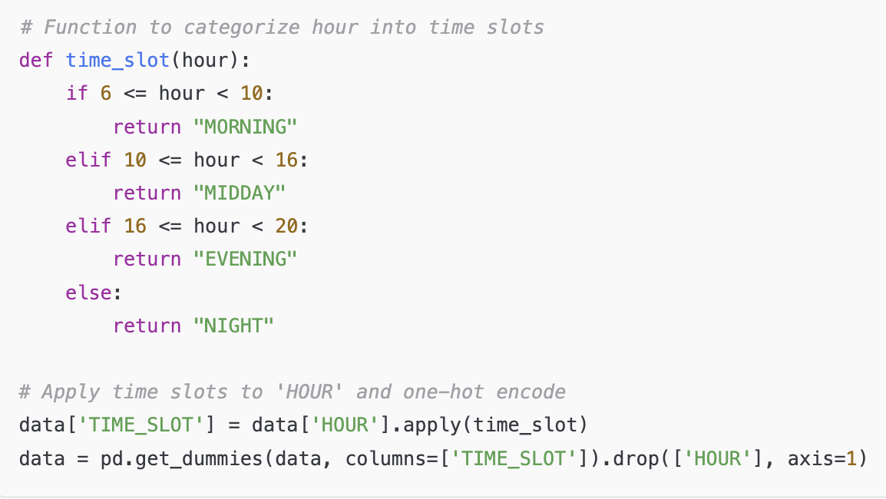
Feature Engineering Hourly Categorization and Encoding
Group hours into time slots
Time Slots:
Morning: 6 AM - 10 AM
Midday: 10 AM - 4 PM
Evening: 4 PM - 8 PM
Night: 8 PM - 6 AM
Implementation:
A function time_slot categorizes each hour into a slot.
One-hot encoding is applied to create separate columns for each time slot.

Slide 27
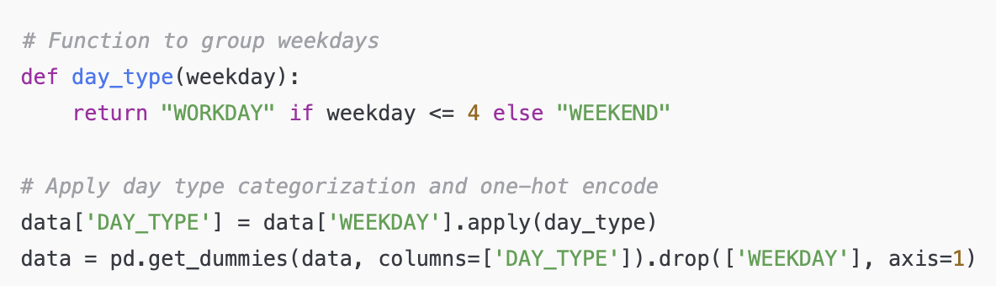
Feature Engineering Weekday Grouping and Encoding
Group days into Workday (Mon-Fri) and Weekend (Sat-Sun)
Implementation:
A function day_type categorizes each day as either WORKDAY or WEEKEND.
The function is applied to create a new column DAY_TYPE.
One-hot encoding is used to split DAY_TYPE into separate columns, and the original weekday column is removed.

Slide 28
Correlation
Correlation Matrix

Slide 29
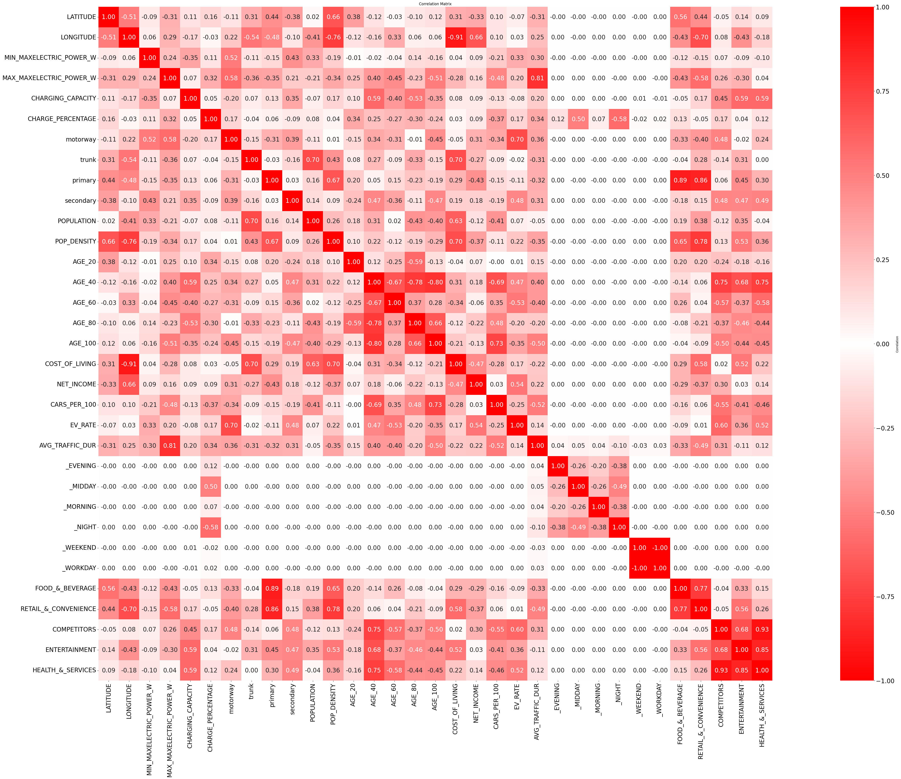
Correlation Correlation Matrix
High correlation between:
AVG_INCOME X NET_INCOME
CHARGING_CAPACITY X NR_OF_CONNECTORS
DROP:
AVG_INCOME
NR_OF_CONNECTORS

Slide 30
Final Dataset
Enriched and preprocessed

Slide 31
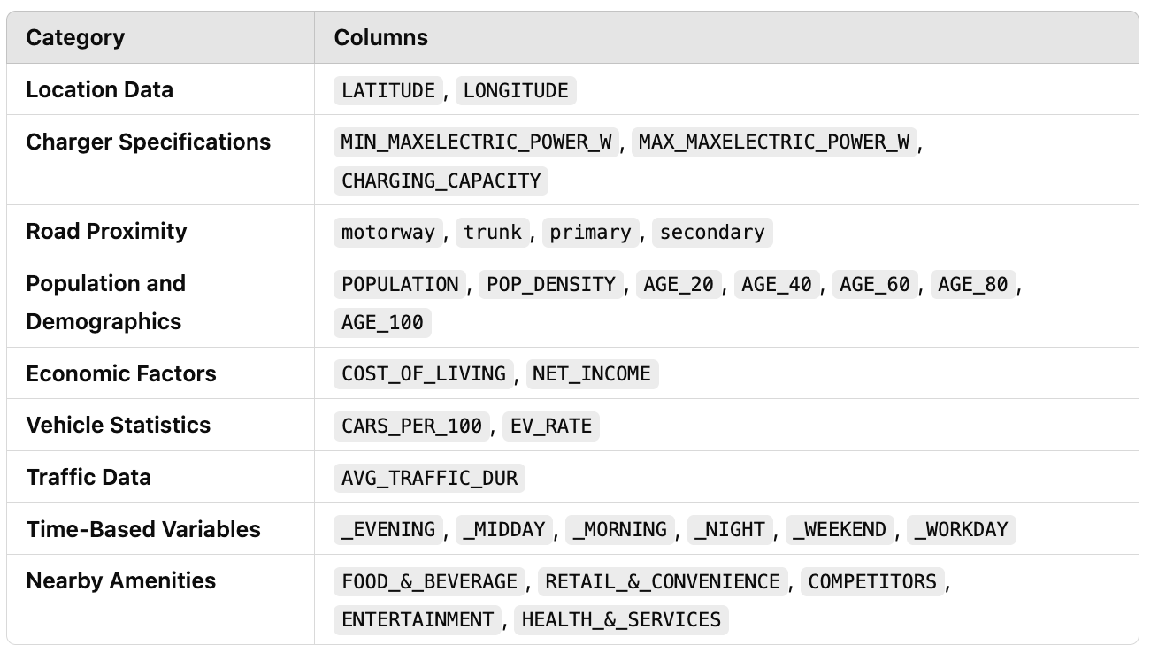
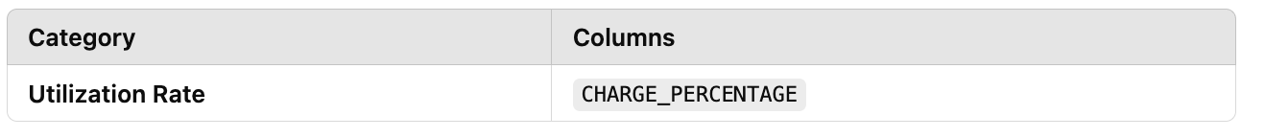
Final Dataset
Features
Target

Slide 32
Model
Train-test split
Features and Labels split
Feature Scaling
Model Selection
Grid Search
Test and Evaluate

Slide 33
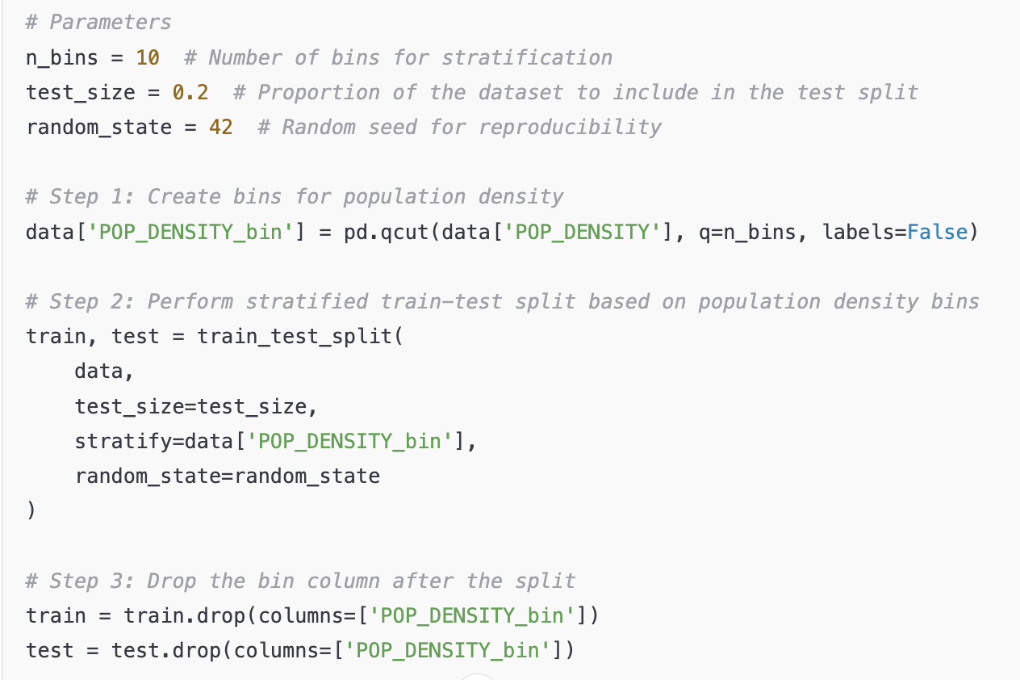
Model Train-Test split
to ensure the target variable's distribution is consistent between the training and test sets.
use stratify= ['POP_DENSITY_bin’] to ensure each split has a similar distribution of population density, as defined by the bins.

Slide 34
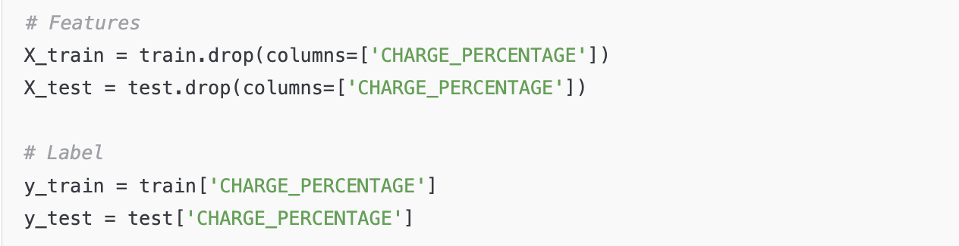
Model Features and Label split

Slide 35
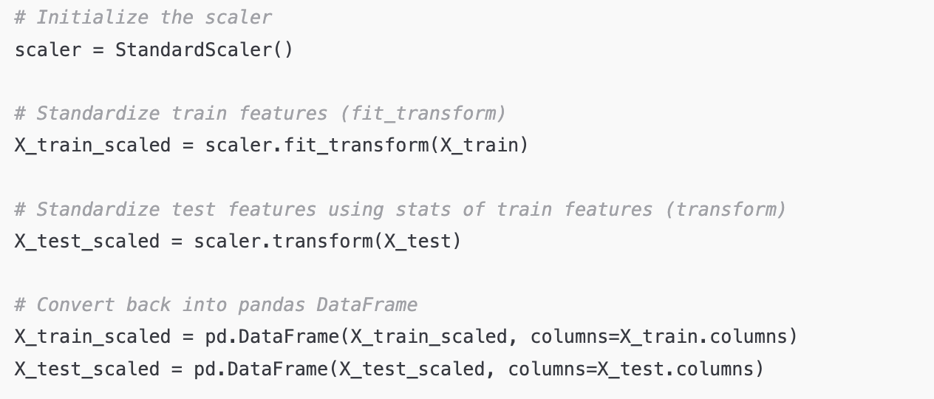
Model Feature Scaling
Fitting and Transforming the Trainin set
Transforming the Test Set

Slide 36
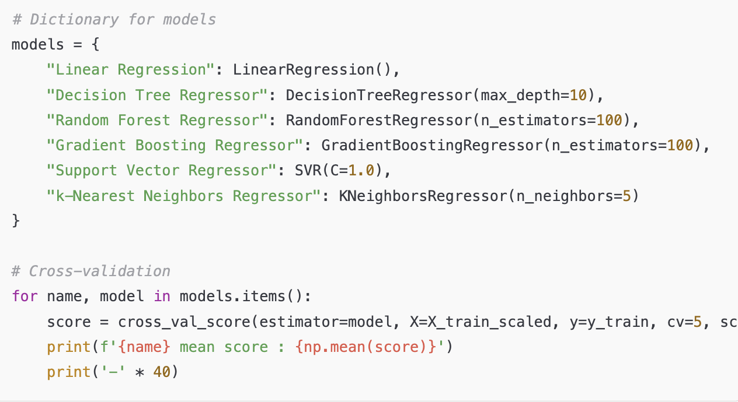
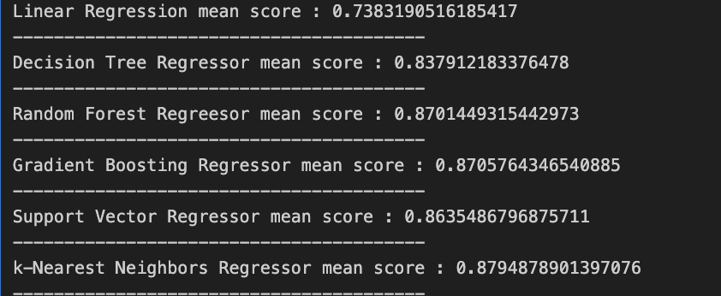
Model Model Selection
Preliminar Evaluation of multiple Regressors
Cross Validation
Top 3 Models
Preliminar R2 score of ~ 88 %

Slide 37
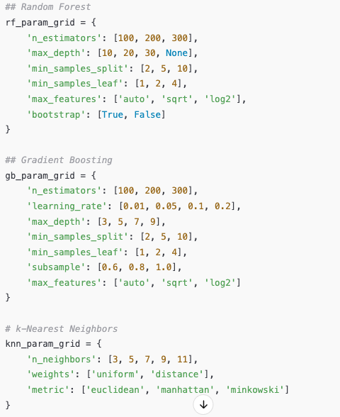
Model Grid Search : Hyperparameters Grid
Random Forest Grid
Gradient Boosting Grid
K-Nearest Neighbors

Slide 38
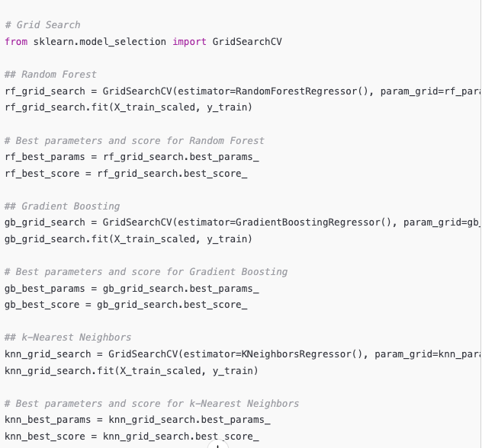
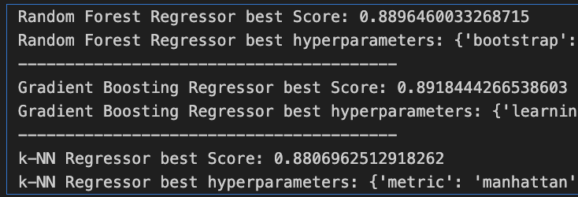
Model Grid Search

Slide 39
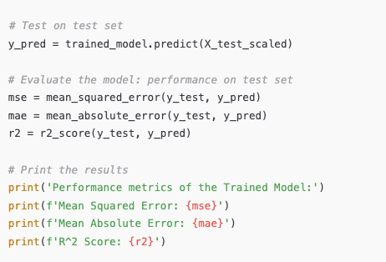
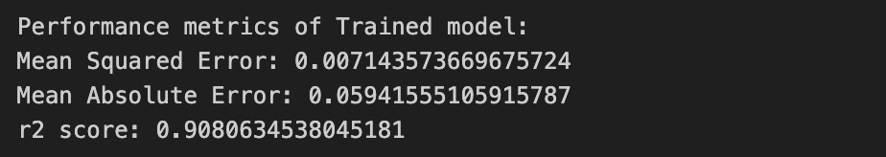
Model Test and Evaluate

Slide 40
Deployment
Streamlit app

Slide 41
Future Work

Slide 42
Future Work
1. Integrate Real-Time Data Sources
Leverage APIs to gather live population and demographic data for enhanced prediction accuracy.
2. Deploy the Model in a Production Environment
3. Expand to Regional and City-Wide Predictions
Create a dynamic color map that displays usage predictions across a specific region, city, or town.
4. Enhance Prediction Accuracy
Experiment with advanced models and algorithms, such as ensemble learning or neural networks, for improved forecasting.

